Slide 1


Project Title -
Seasonal Agriculture Performance Analysis
Name: Alekhya Allatipalli
College Name: Shri Vishnu Engineering College for Women
AICTE STU ID :
STU69df4d8150f3e1776242049
9/2/2026
Annual Review
‹#›

Slide 2

PROBLEM STATEMENT
• Agricultural activities are influenced by seasonal variations in environmental conditions,
farming practices, resource availability, and market conditions.
• As a result, agricultural performance may differ from one season to another.
• Raw agricultural data does not clearly explain how agricultural performance changes across seasons.
• It is important to identify patterns, trends, relationships, and variations
in different seasonal conditions.
• This project analyzes the agricultural dataset to investigate seasonal differences
in agricultural performance.
• The analysis aims to provide meaningful insights from the available agricultural data.
9/2/2026
Annual Review
‹#›

Slide 3
Project Description
• This project analyzes agricultural performance across different seasons.
• Studies the effect of environmental conditions and farming practices on
agricultural performance.
• Examines crop production, resource usage, and economic performance.
• Compares agricultural performance across different seasons and conditions.
• Identifies patterns, trends, relationships, and variations in the data.
• Uses data analysis and visualization techniques to understand the agricultural data.
• Provides meaningful insights and data-driven recommendations for
better seasonal agricultural planning.
9/2/2026
Annual Review
‹#›

Slide 4

End Users
• Farmers – To understand seasonal crop performance and improve farming decisions.
• Agricultural Planners – To support better seasonal agricultural planning.
• Agricultural Researchers – To study seasonal patterns, trends, and relationships.
• Agriculture Departments – To understand regional and seasonal agricultural performance.
• Resource Managers – To analyze resource usage such as water and farming inputs.
• Agribusiness Stakeholders – To understand production and economic performance across seasons.
9/2/2026
Annual Review
‹#›

Slide 5

Technology Used
• Python – Main programming language used for data analysis.
• Pandas – Used for data loading, cleaning, manipulation, and analysis.
• NumPy – Used for numerical operations and calculations.
• Matplotlib – Used to create data visualizations and charts.
• Seaborn – Used to create statistical plots and advanced
visualizations.
• Google Colab – Used as the working environment for performing
and documenting the analysis.
9/2/2026
Annual Review
‹#›
Notes:
5

Slide 6
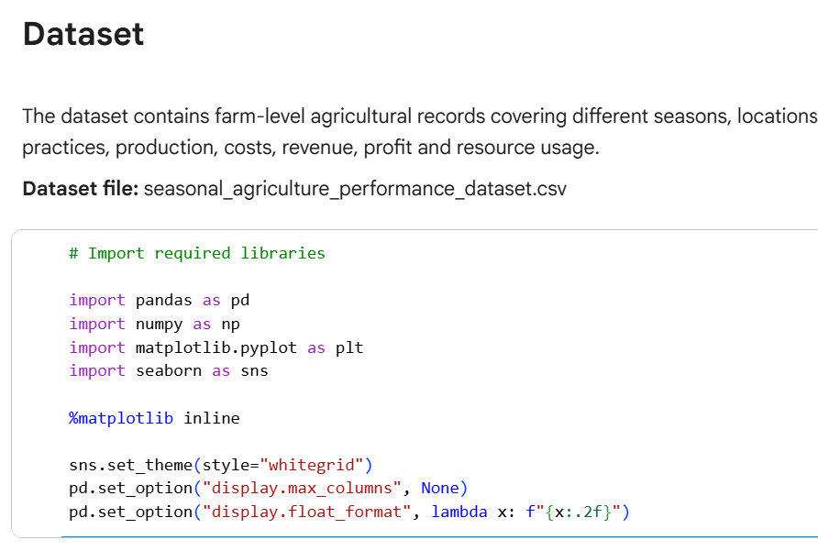
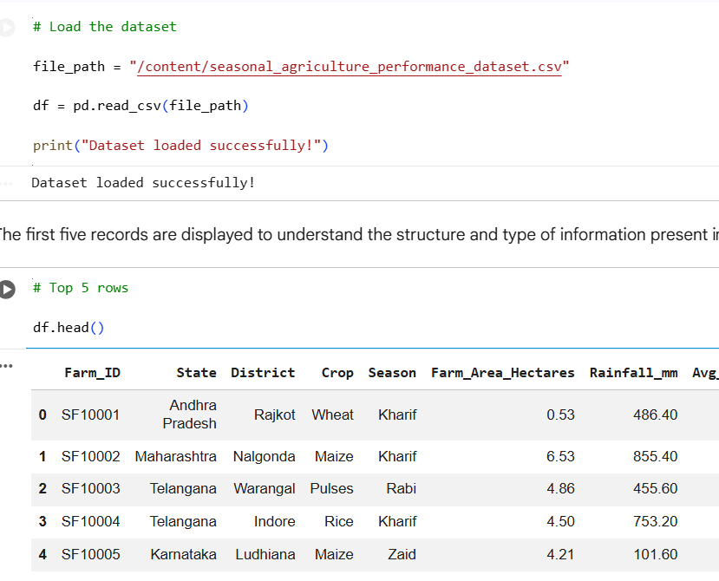
RESULTS
These libraries provide the basic tools required to explore,
analyze, and visualize the agricultural data.
• The agricultural dataset is loaded into Python
using Pandas for further analysis.
9/2/2026
Annual Review
‹#›

Slide 7
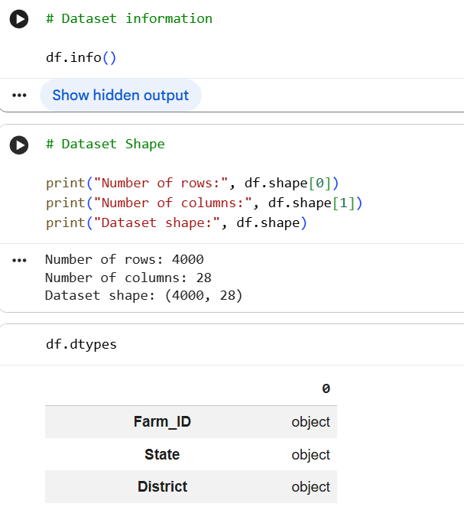
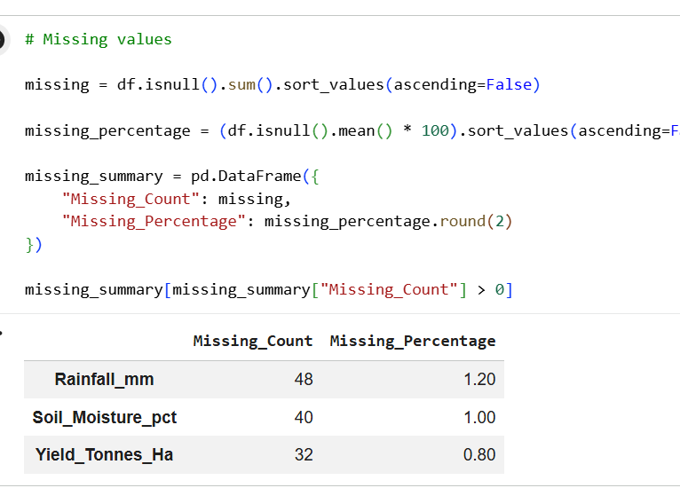
RESULTS
• info() shows the dataset structure, shape shows its size, and
dtypes shows the data types of each column.
• Missing values were identified and analyzed to understand their extent
and pattern before applying suitable treatment.
9/2/2026
Annual Review
‹#›

Slide 8
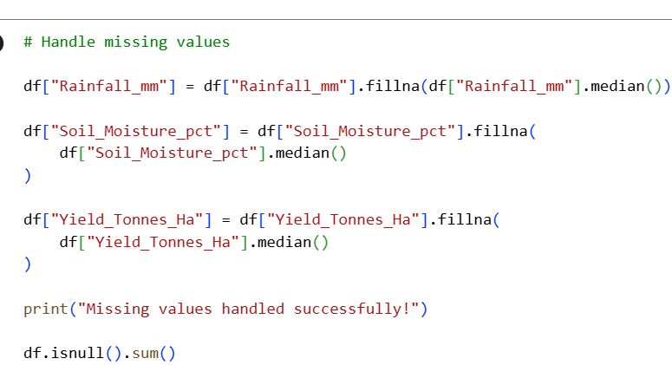
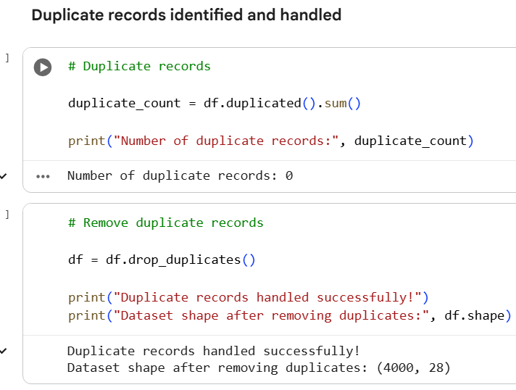
RESULTS
• Missing values were handled using median imputation for the affected
numerical columns, followed by verification to ensure the missing
values were removed.
• Duplicate records were checked and removed to ensure that
repeated data does not affect the accuracy of the analysis.
9/2/2026
Annual Review
‹#›

Slide 9
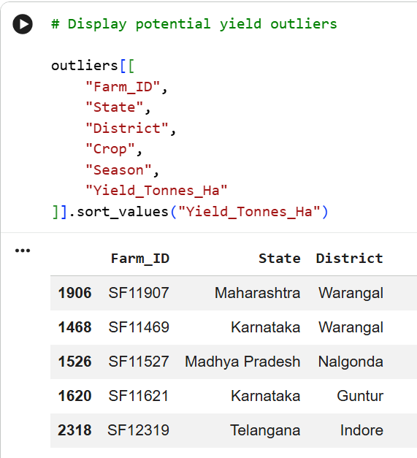
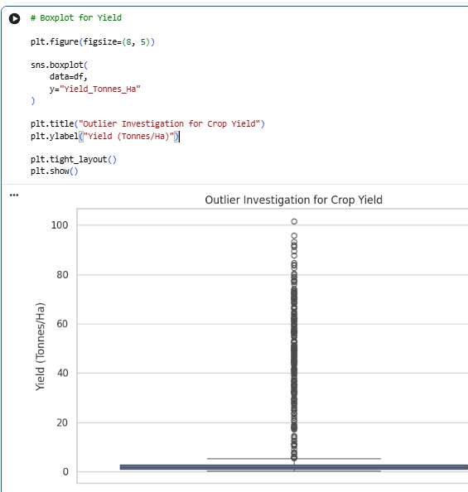
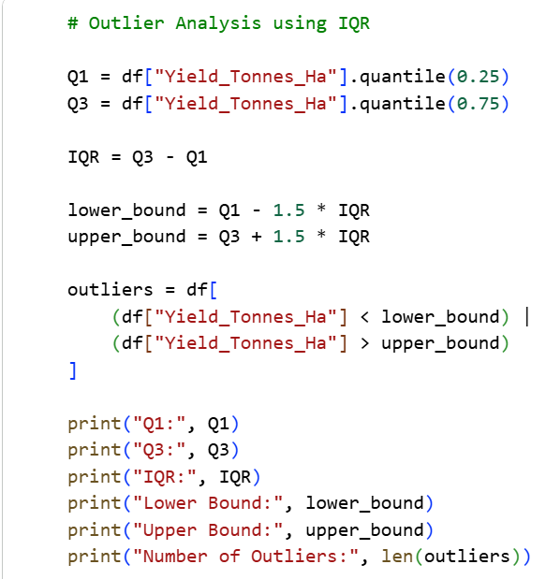
RESULTS
• Identifies unusual or extreme values in the dataset.
• Potential outliers were reviewed rather than automatically removed,
as they may represent genuine agricultural conditions.
9/2/2026
Annual Review
‹#›

Slide 10
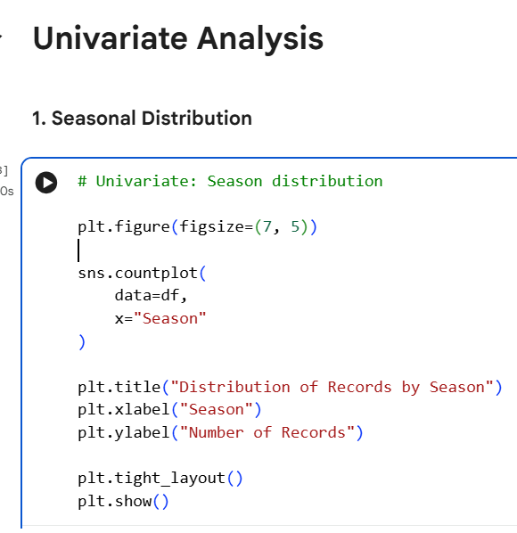
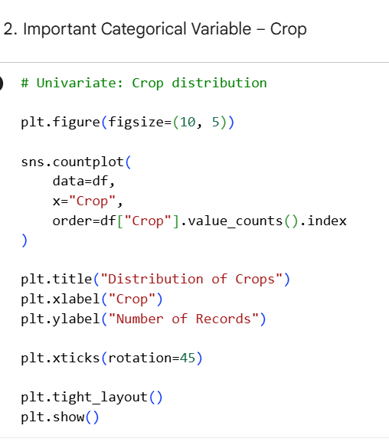
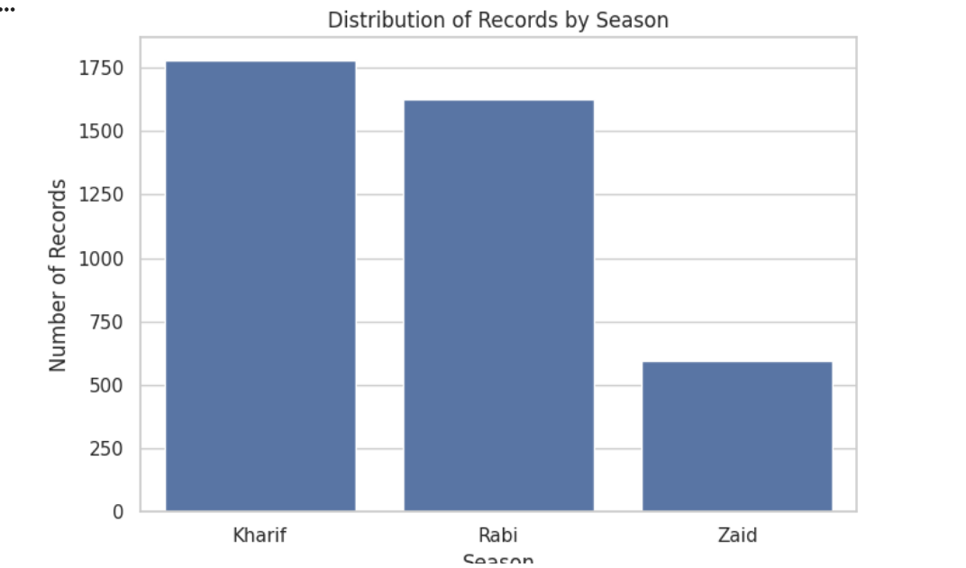
RESULTS
• Analyzes one variable at a time to understand its distribution, frequency, and variation.
• In this project, crop distribution, yield distribution, season distribution, and outliers were analyzed
using charts such as histograms, count plots, pie charts, and boxplots.
9/2/2026
Annual Review
‹#›

Slide 11
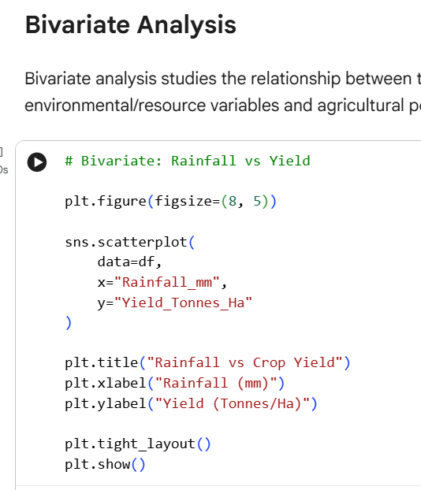
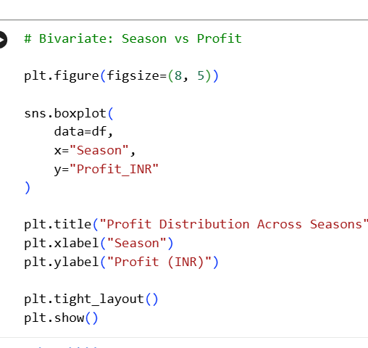
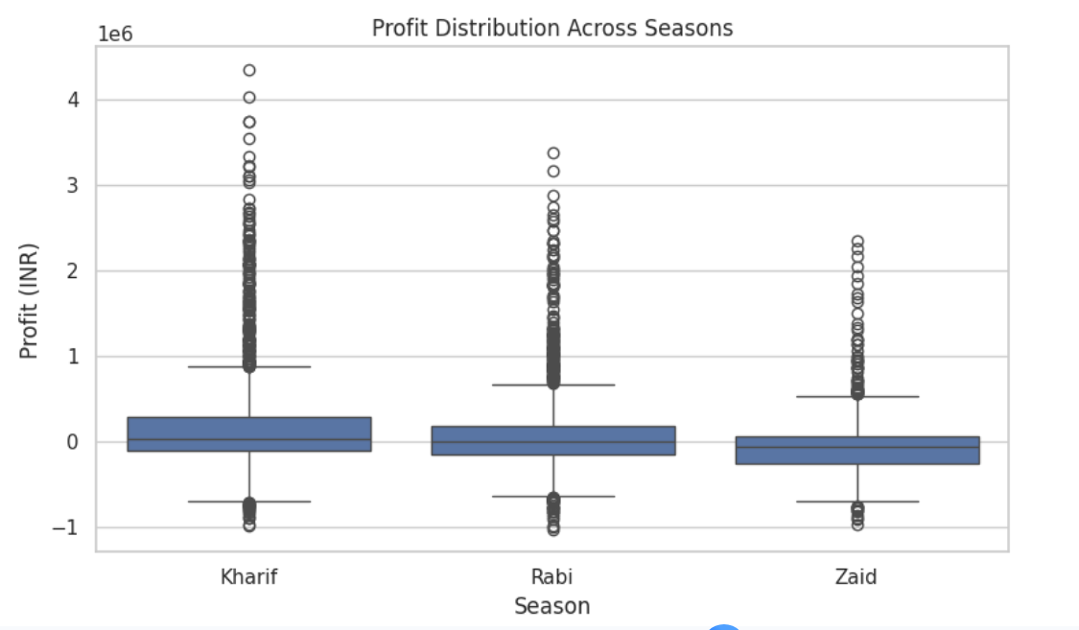
RESULTS
• Analyzes the relationship between two variables to identify patterns and associations.
• In this project, relationships such as Rainfall vs Yield, Farm Area vs Production, Season vs Yield, and Irrigation Method vs Yield were analyzed using visualizations.
9/2/2026
Annual Review
‹#›

Slide 12
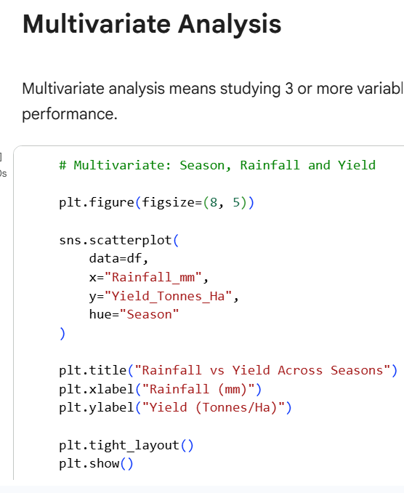
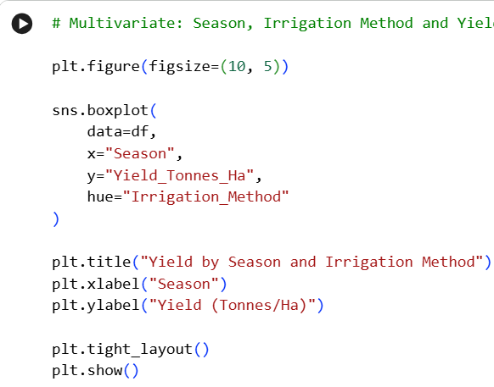
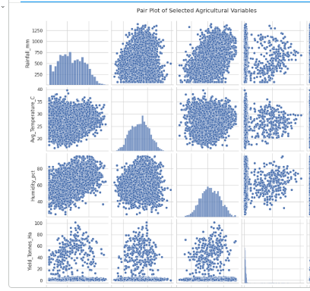
RESULTS
• Analyzes three or more variables together to understand complex relationships and patterns in agricultural data.
• In this project, rainfall, temperature, humidity, yield, production, and season were analyzed together using pair plots and other visualizations.
9/2/2026
Annual Review
‹#›

Slide 13
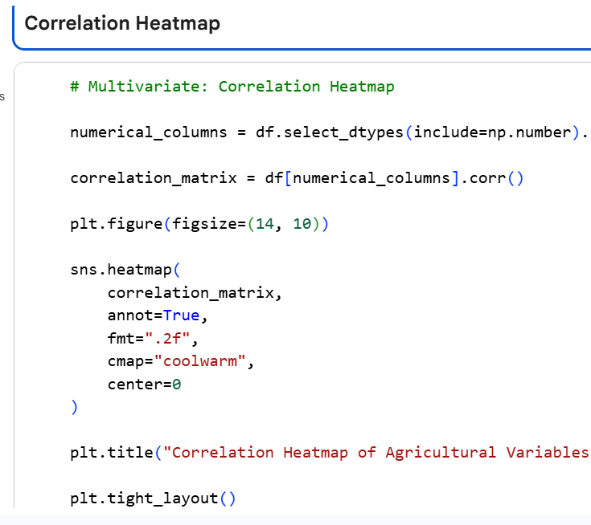
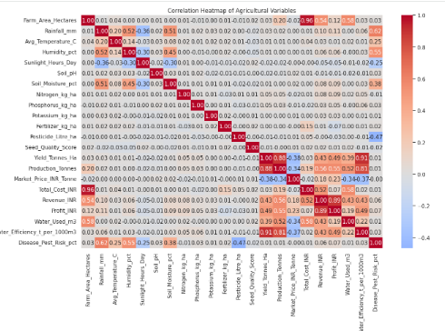
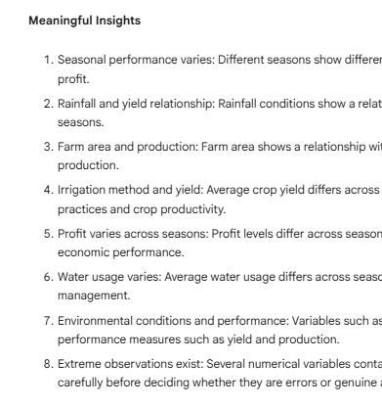
RESULTS
• Correlation analysis identifies the strength and direction of relationships between numerical variables.
• In this project, correlations between environmental factors, resource usage, yield, production, and profit were analyzed using a correlation matrix and heatmap.
9/2/2026
Annual Review
‹#›

Slide 14
Future scope
• Analyze larger agricultural datasets covering more regions and seasons.
• Include additional environmental and farming-related factors for deeper analysis.
• Perform more detailed comparisons between crops, regions, and seasons.
• Use long-term weather and agricultural data to identify seasonal trends over time.
• Develop advanced analytical methods to improve agricultural planning and decision-making.
• Use the findings to support efficient resource management and better seasonal planning.
9/2/2026
Annual Review
‹#›

Slide 15
GitHub Link
https://github.com/Alekhya2508/Seasonal-Agriculture-Performance-Analysis.git
9/2/2026
Annual Review
‹#›

Slide 16
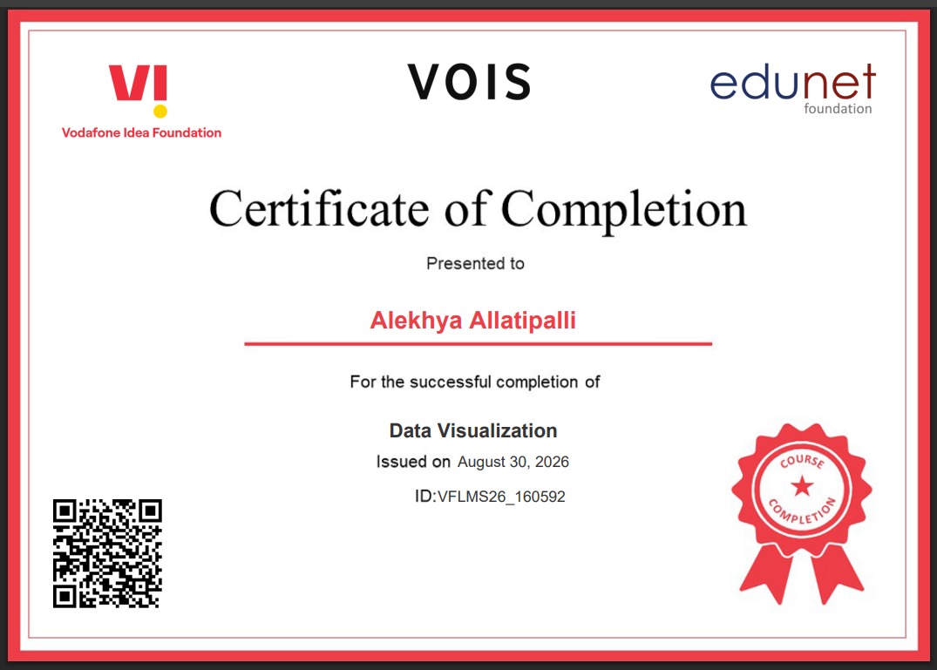
VOIS Course completion certificate -
Course name- Data Visualization
9/2/2026
Annual Review
‹#›

Slide 17

Thank you
Thank You for Your Attention!
Seasonal Agriculture Performance Analysis
• Presented by: Alekhya Allatipalli
AICTE STU ID :
STU69df4d8150f3e1776242049
.
Any Questions?
.
8/27/2026
Annual Review
‹#›

